Slide 1
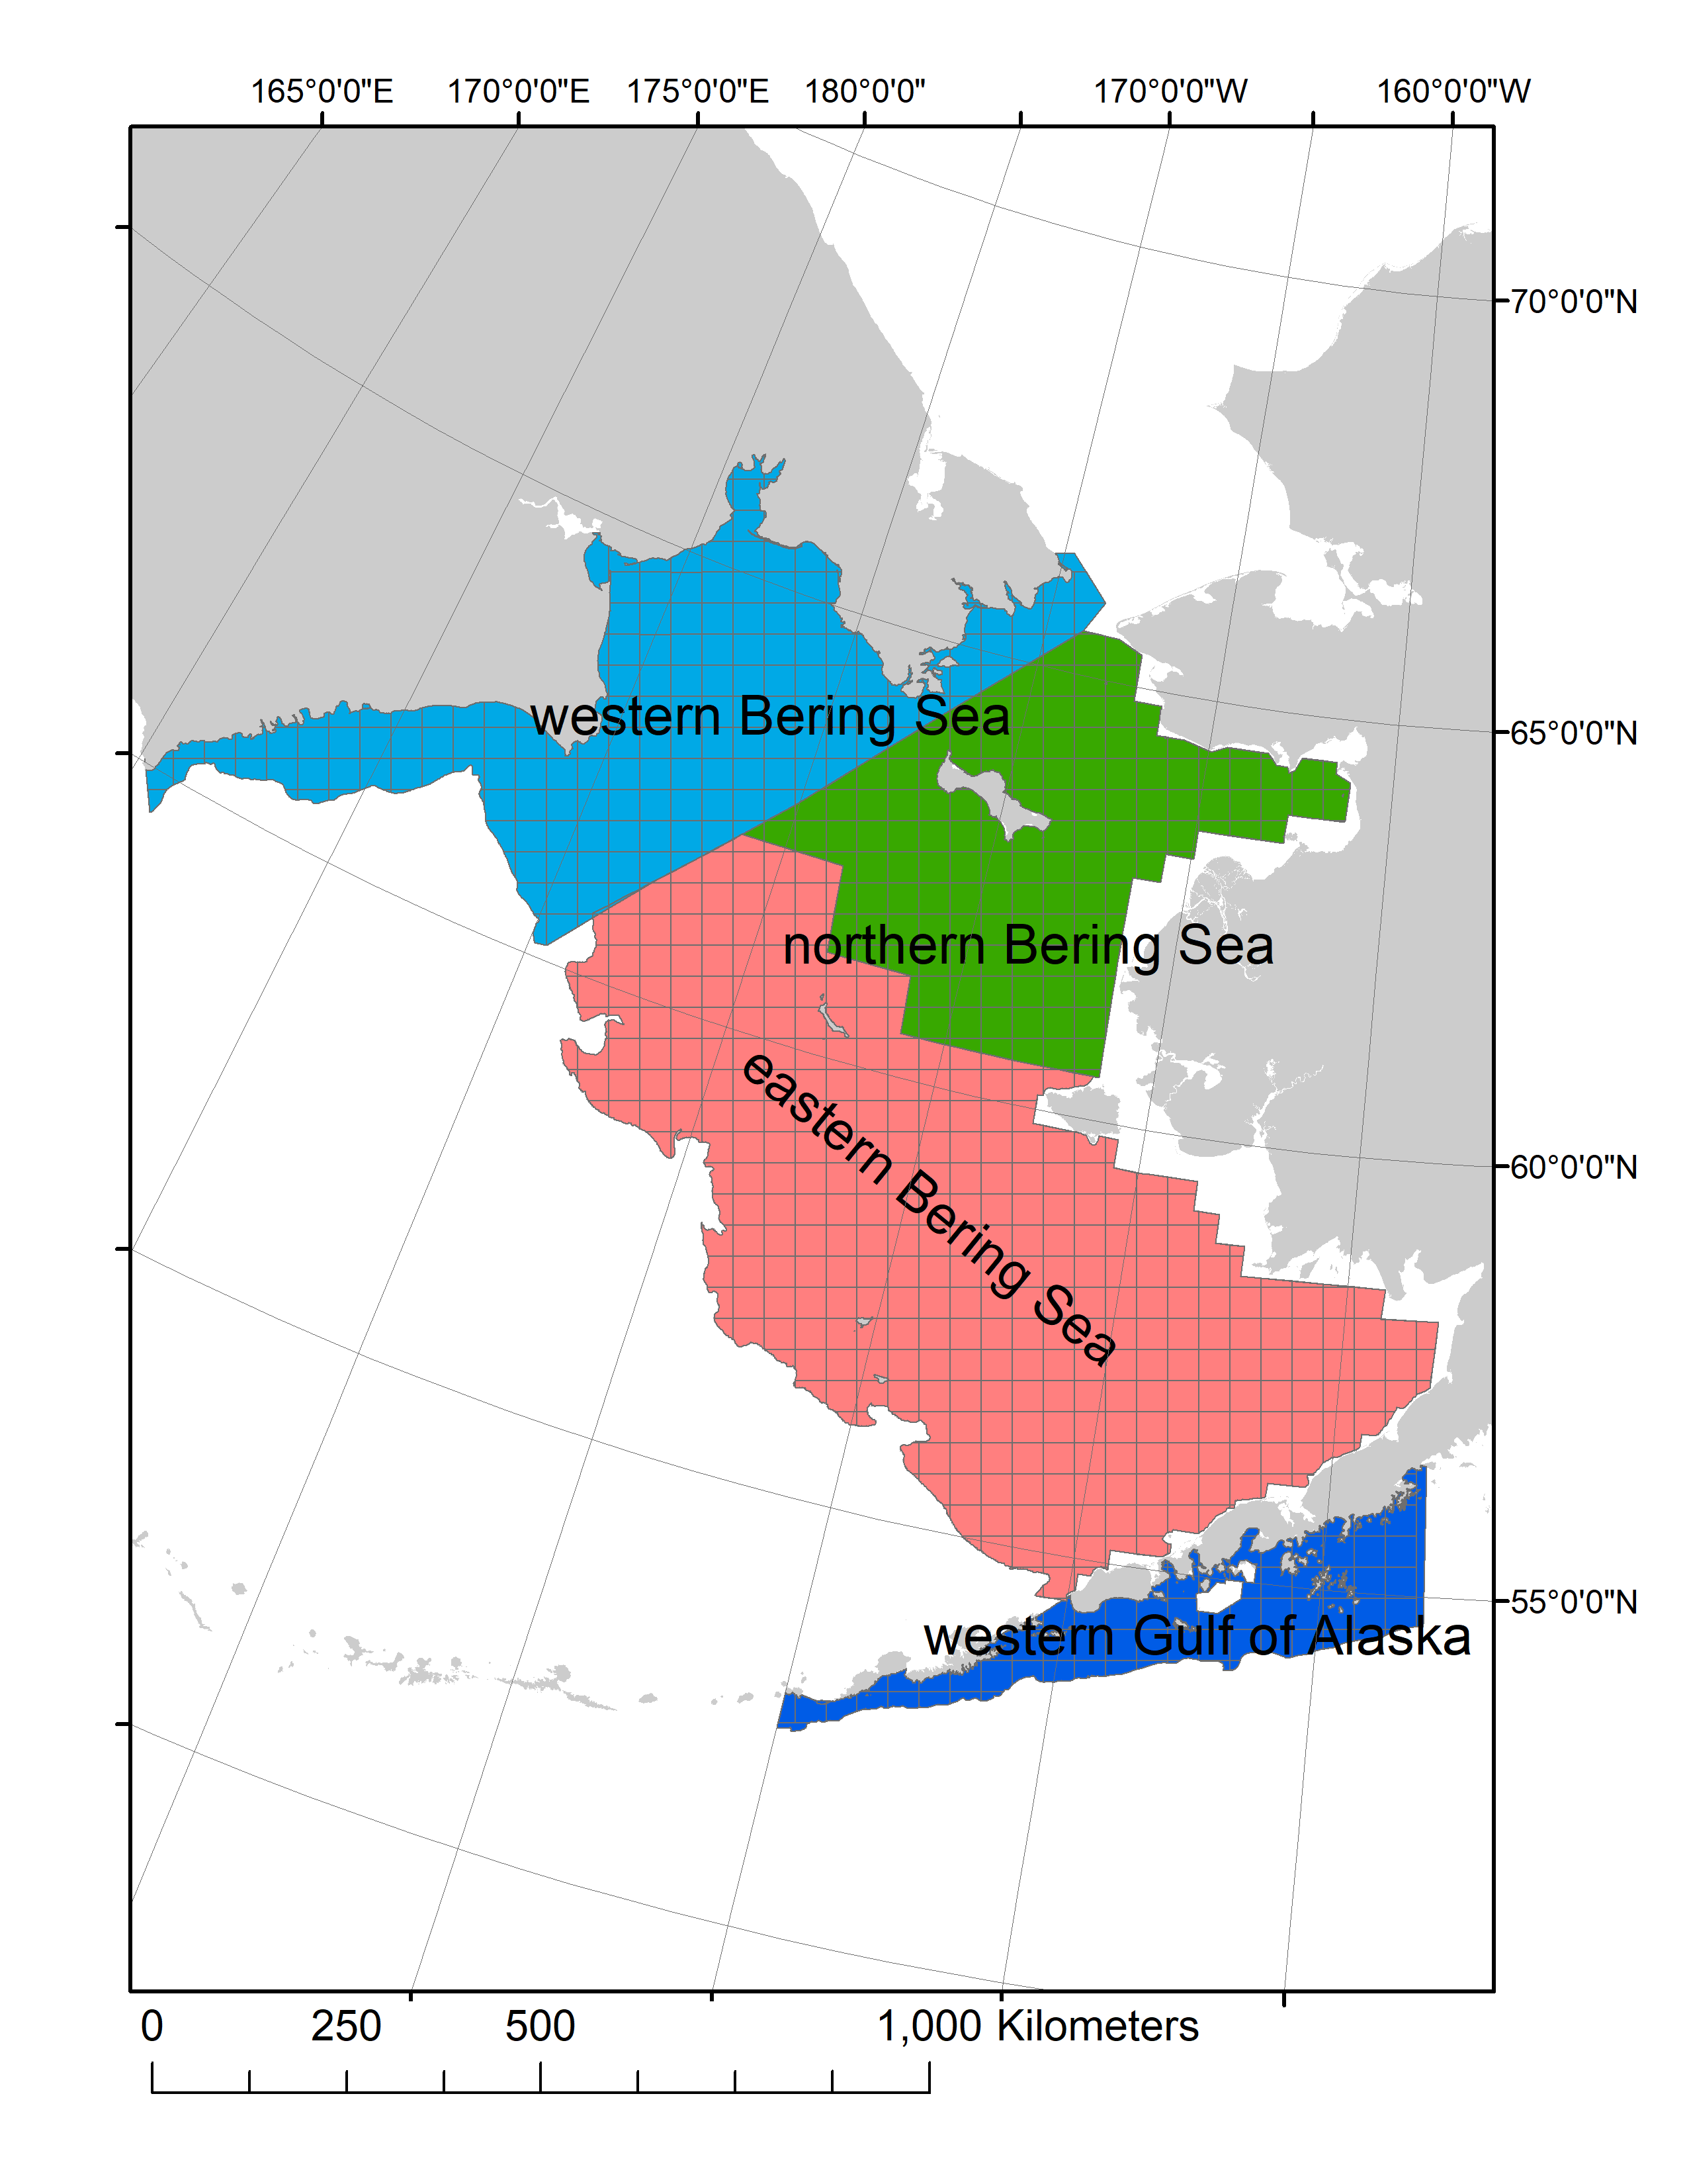
What about the western Bering Sea?
Tagging data show consistent Pacific cod movement among the eastern, northern, and western Bering Sea.
Genetic specimen of the western Bering Sea group among the eastern Bering Sea samples.

Slide 2
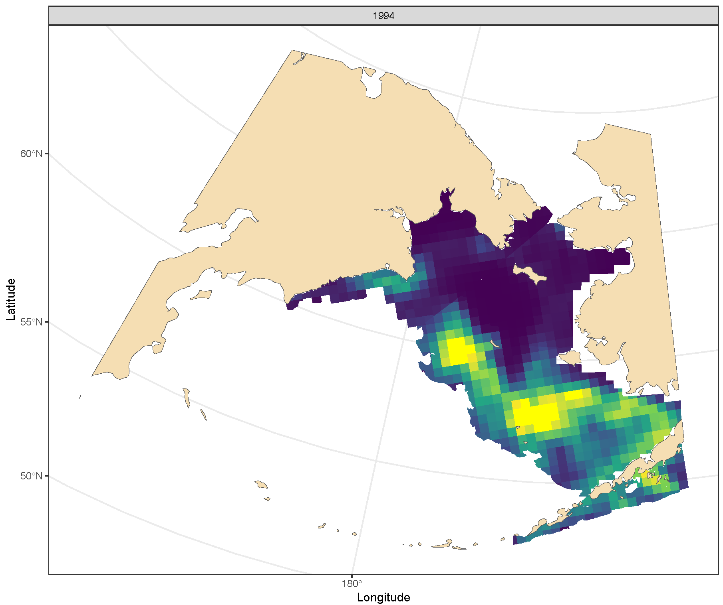
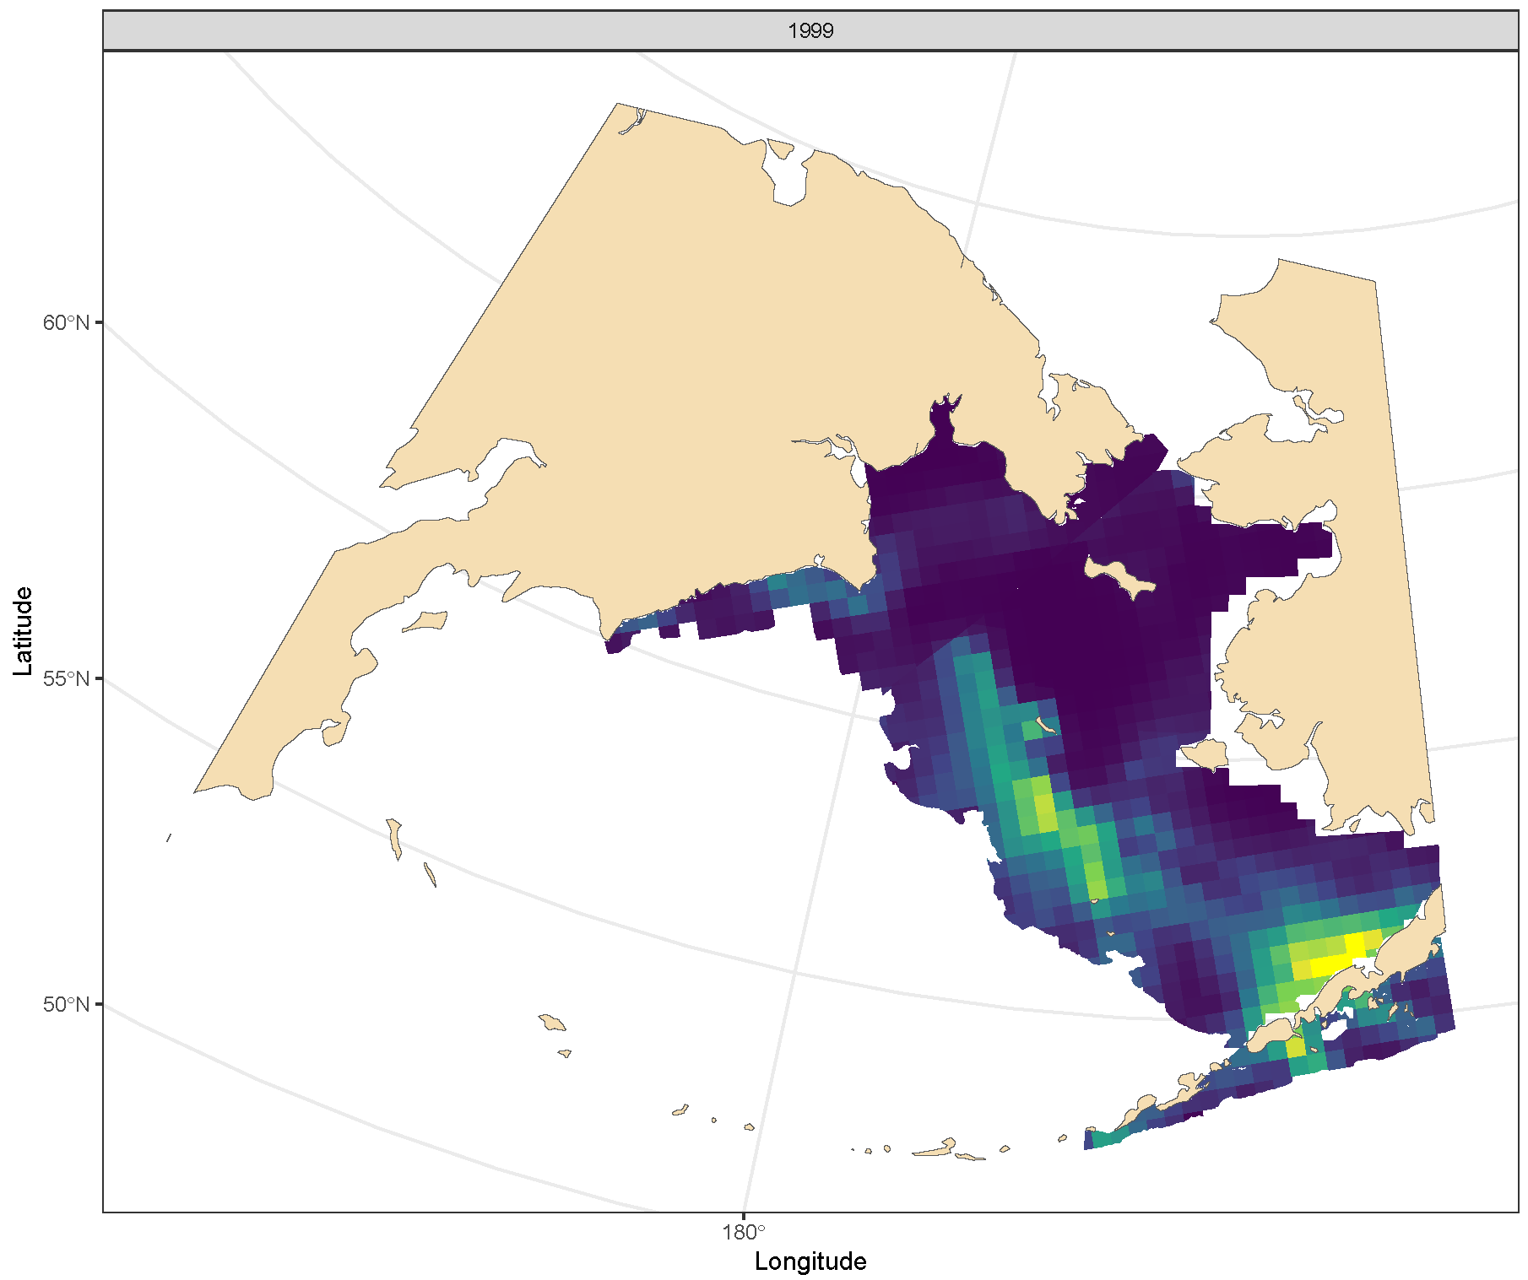
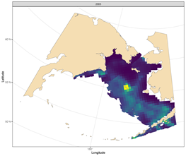
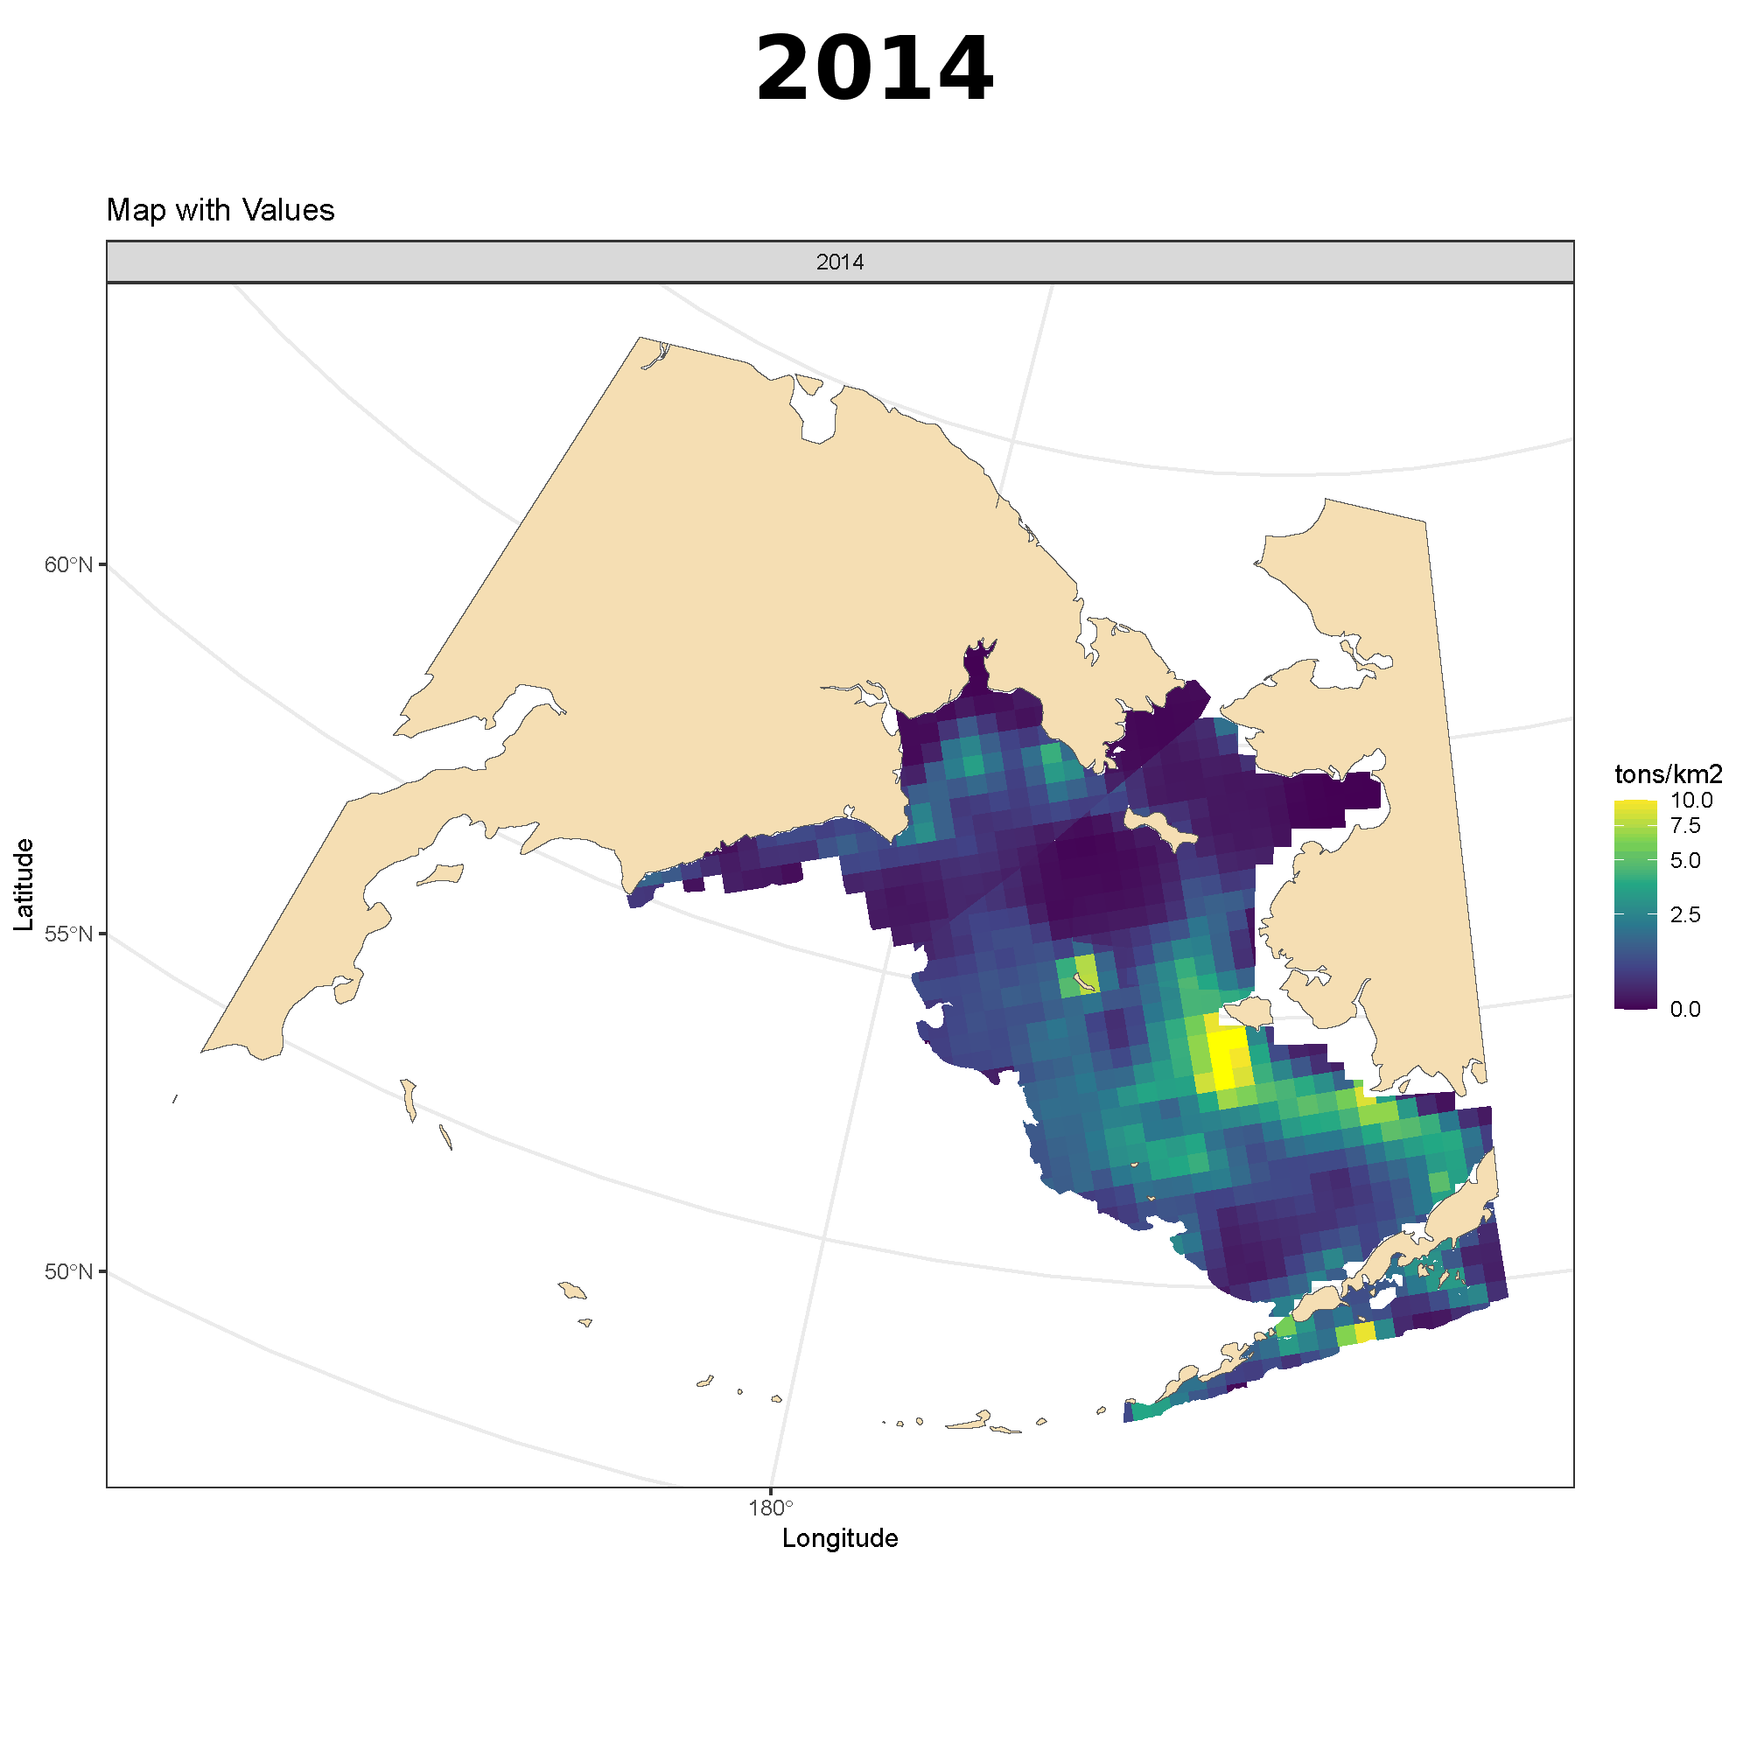
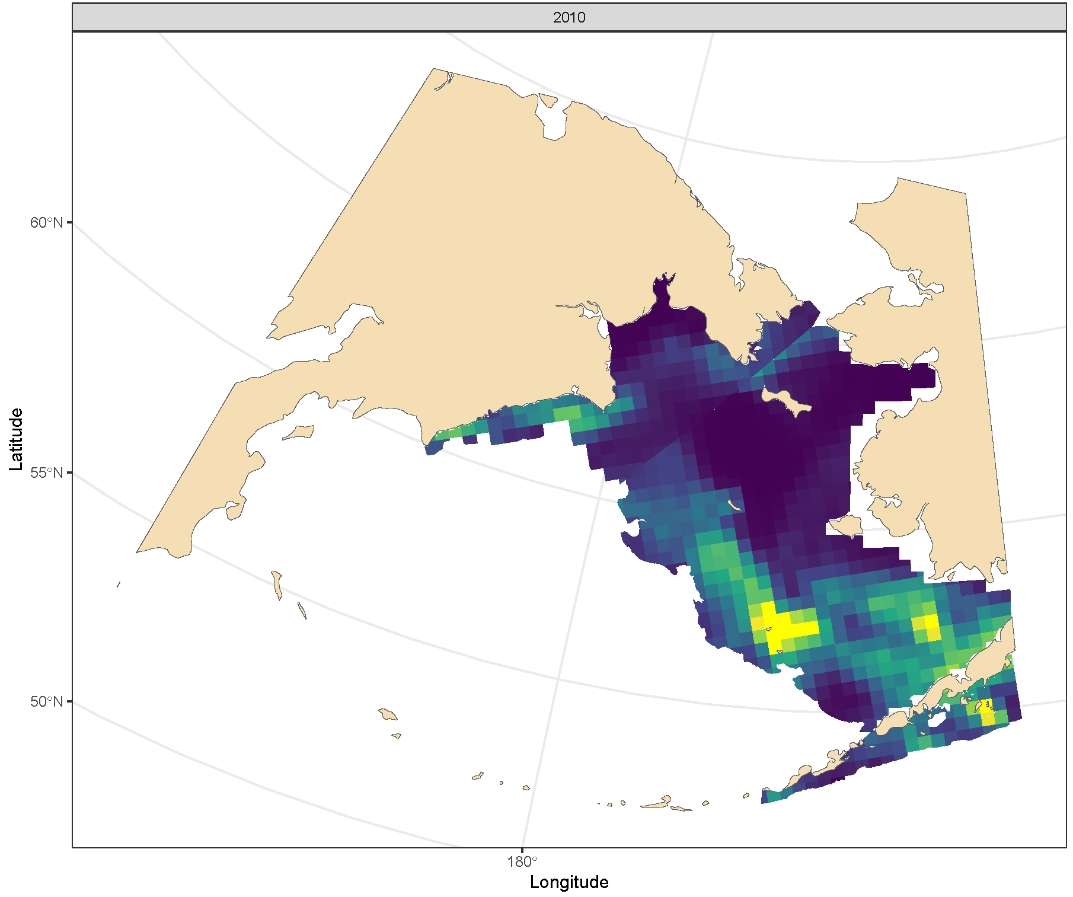
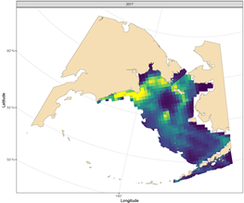
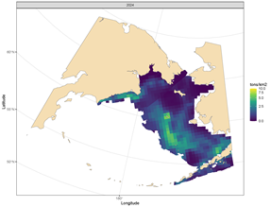
sdmTMB indices
Density plots (t/km2) of Pacific cod distribution for 1994, 1999, 2003, 2010, 2017, and 2024 from the sdmTMB projection with WBS survey data from the western Bering Sea
1994
1999
2003
2010
2017
2024

Slide 3
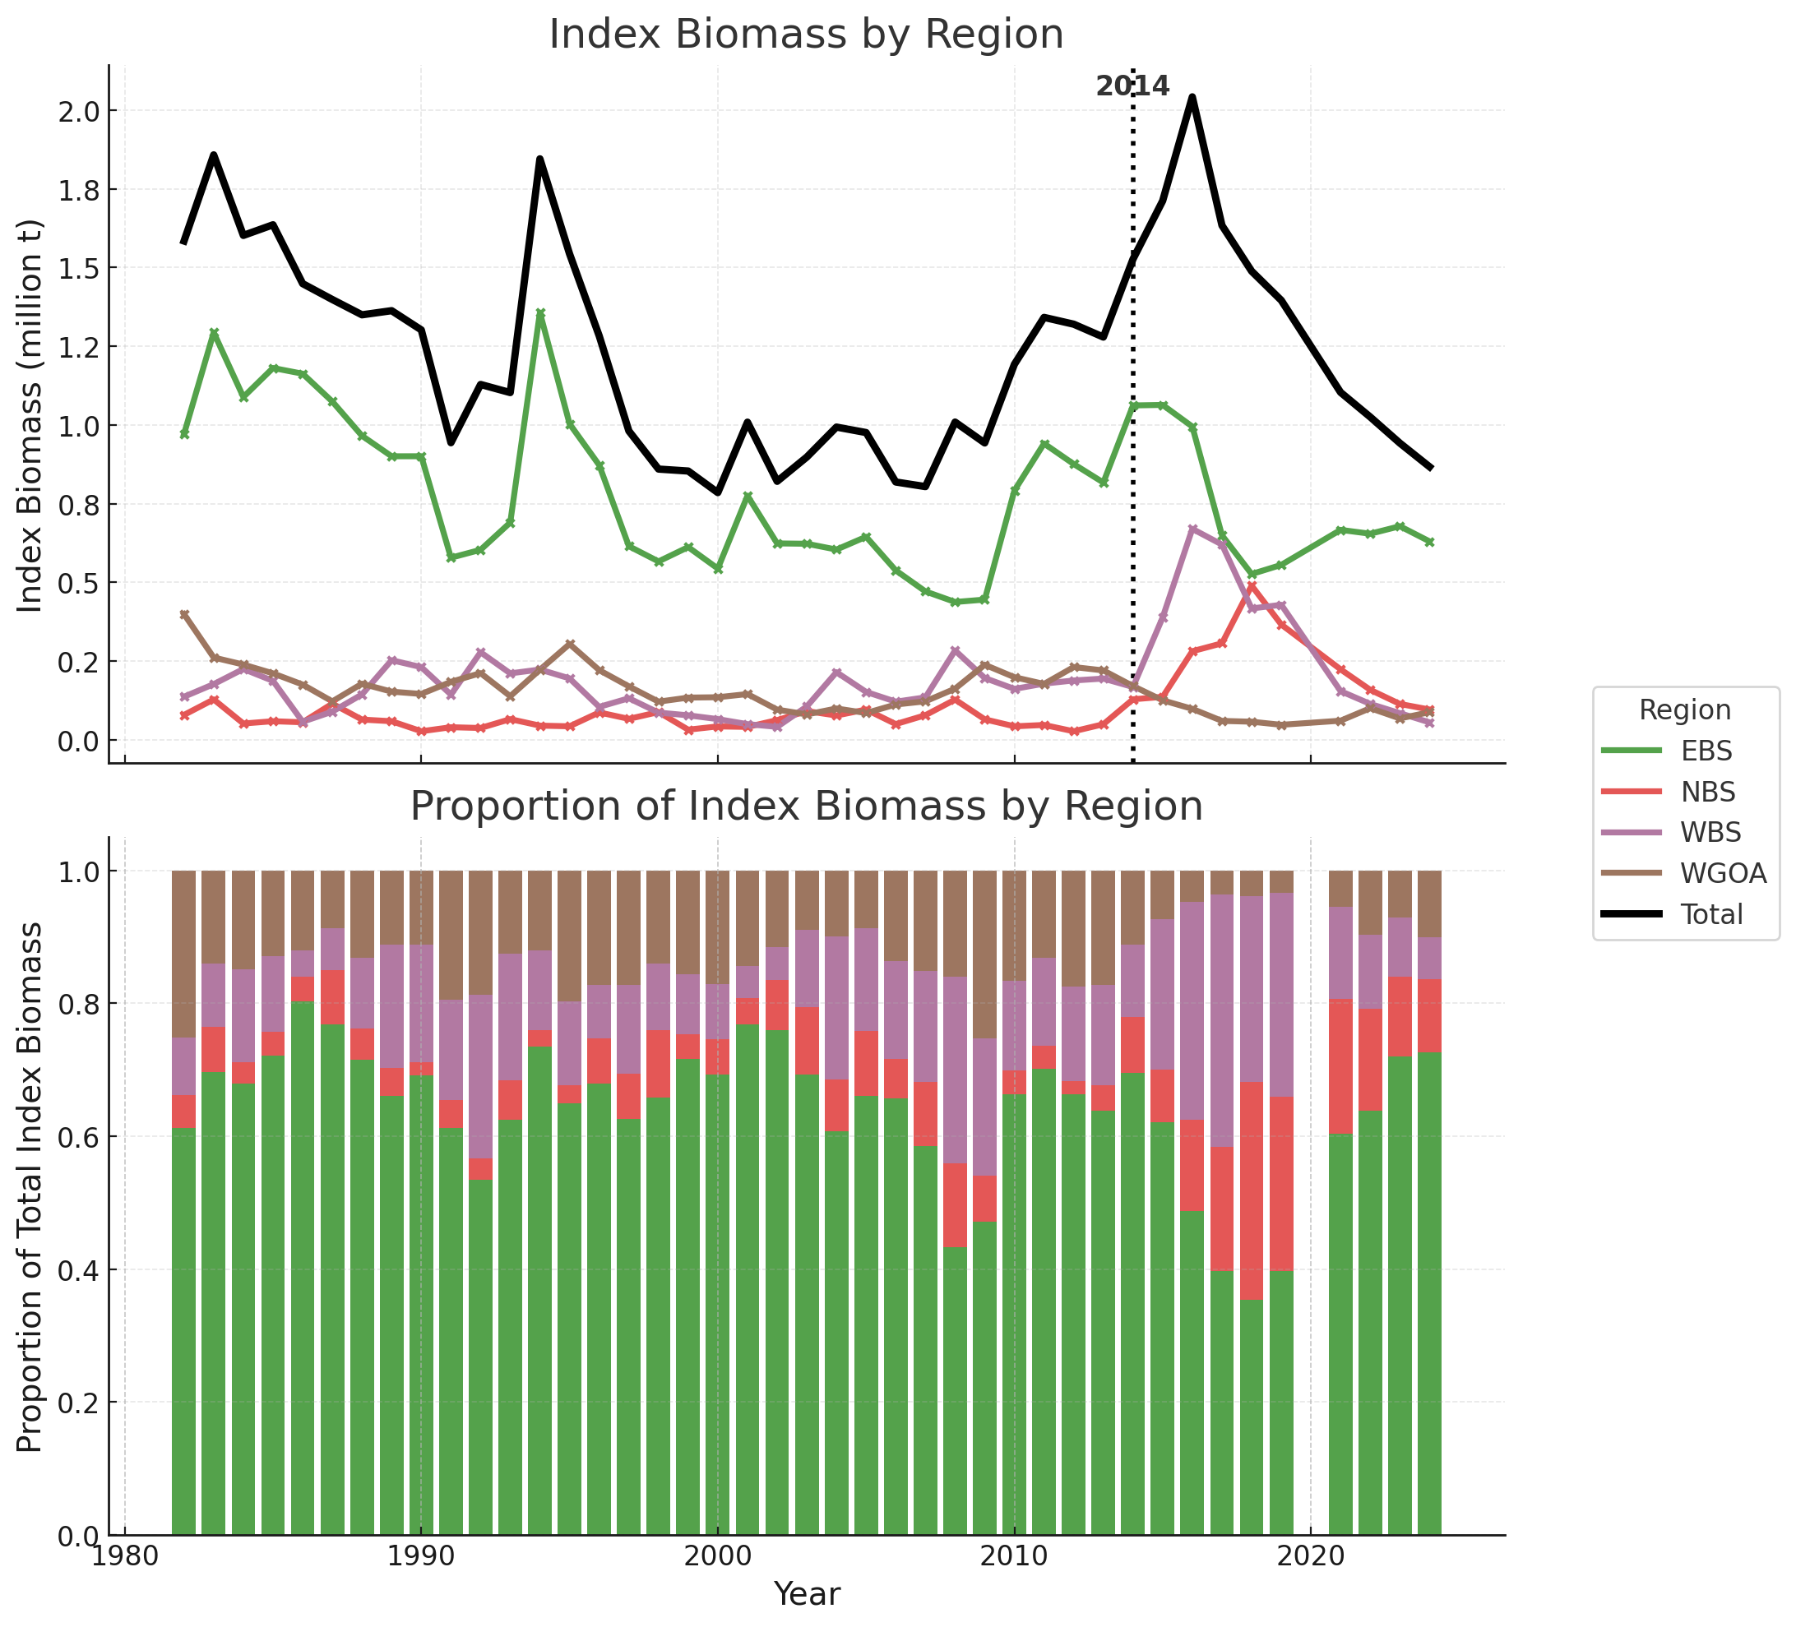
sdmTMB indices
Shift in biomass distribution to WBS and NBS post-2014
The average proportion of biomass in the WBS compared to the all areas for 1982-2014 was 13.3%
For 2015-2019 that proportion rose to 30.4%
For 2024 the WBS share of biomass has dropped to 6.3%
Although an increase in NBS biomass started prior to the WBS increase, it peaked in 2018, two years after the WBS.

Slide 4
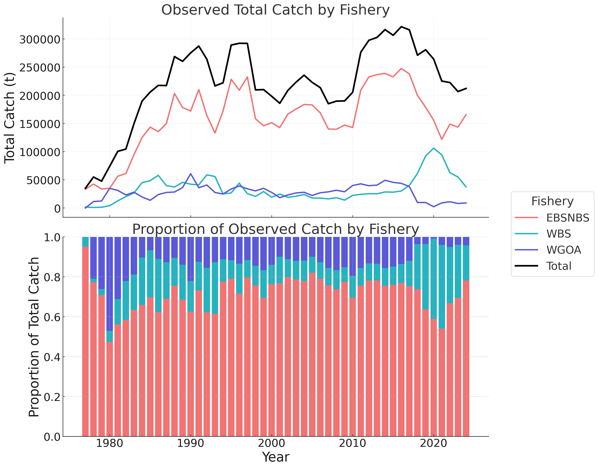
Western Bering Sea catch increase
Western Bering Sea Pacific cod catch has increased substantially in the last 5 years.
From 1990-2016 WBS catch average ~27,600t (13.1% of the total Bering Sea catch)
For 2017-2024 WBS catch averaged 68,700 t (28.9% of the total Bering Sea catch) with a peak catch of 106,200 t in 2020

